Slide 1
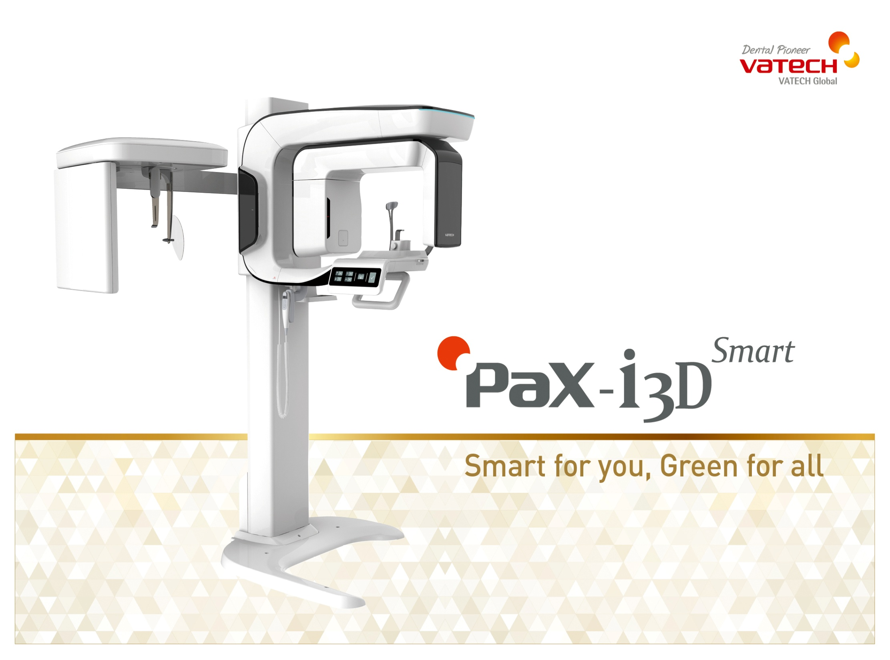


Green for all, Smart for you
Copyrightsⓒ VATECH Global, Ltd. All rights reserved.

Slide 2


“Green for all, Smart for you”
Green Innovation
Low Dose CT
One Scan, Two Images
Image Quality Innovation
Reconstruction Technology
Auto MAR Technology
Magic PAN Technology
FOV Innovation
Arch-shaped FOV
Extended 10x8.5 FOV
Software Innovation
Ez3D-i

Slide 3

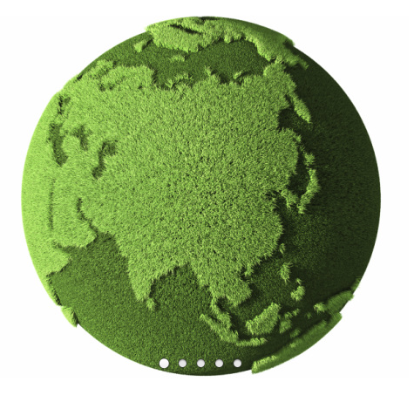
World’s 1st Low Dose Green Sensor Manufacturer
You don't need to imagine anymore. Low dose radiation scans are a reality.
Imagine a device that can provide superior diagnostic quality radiograph and significantly lower dose at the same time.
Imagine what it all can do for a dental practice and patient safety.

Slide 4


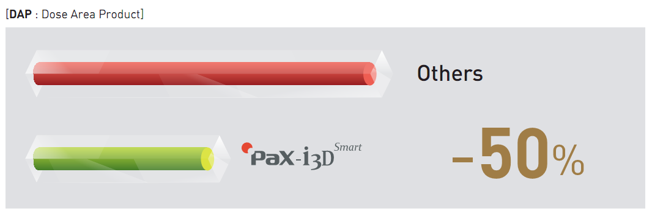


Green Innovation : Low Dose CT (1)
VATECH’s low dose X-ray technology reduces radiation level of PaX-i3D Smart;
50% lower than other imaging machines.
PaX-i3D Smart provides specific imaging mode for children and it is resulted from
our efforts to protect children more from radiation.
Normally, FOV 8x8 imaging machine has about DAP 800~1,000.
If you convert radiation level of PaX-i3D Smart(10x8.5) to FOV 8x8, the level is under DAP 300.

Slide 5


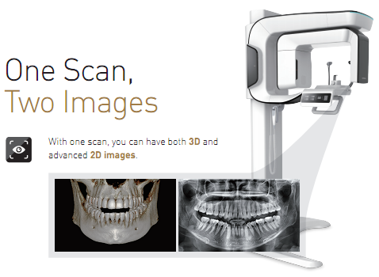

Green Innovation : One Scan, Two Images (1)
PaX-i3D Smart gives you more!
With just one scan, you can have both 3D and advanced 2D images.
CT scanning provides not just CT image but panoramic image which you are accustomed to.
For this, patients who require both images, no need to be under
X-ray two times.
Plus, what’s better thing is both images are displayed within one viewer.
(Available on Ez3D-i V4.0 in 2015)
* Only panoramic image can be acquired.
Notes:
정확한 3D 진단이 가능한, High Image Quality의 CT영상 제공-
여기에 Plus alpha로 너가 익숙한 Pano영상을 제공-
이 Pano영상은 번거롭게 2D Viewer를 추가로 열지 않고, 3D Viewer에서 볼 수 있다.

Slide 6
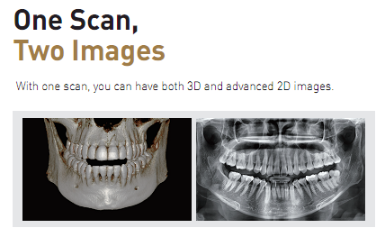
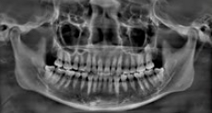
Green Innovation : One Scan, Two Images (2)
PaX-i3D Smart gives you more!
With just one scan, you can have both 3D and advanced 2D images.
3D Data
DIRECT Reconstruction
(Innovative Reconstruction Algorithm)
3D Volume
Reconstruction using 3D volume data
VT Real Pano
Recon. Pano
Acquired in the similar way
with Traditional Panorama
Have limitations of 3D raw data
Resolution
Metal Artifact
Notes:
VT Real Pano는 CT 촬영 중에 획득된 데이터를 3차원 FOV로 재구성하기 전에 Scan Pano 재구성 방법과 유사한 방법으로 영상을 재구성하기 때문에 해상도 및 Artifact 등에 대한 단점을 조금 보완할 수 있음.
물론 Scan Pano와 동등 수준의 품질을 구현하기에는 어려움이 있으나, 일반적인 Viewer에서 제공하는 Recon. Pano와 비교하여 더욱 Scan Pano와 유사한 영상을 보여준다는 특징이 있음.
CT찍으면 Pano영상이 나오는 방식이 두가지 있음. 하나는 CT영상을 가지고 재구성하는 Recon. Pano랑, CT구동을 Pano 궤적과
비슷하게 만들어 Projection을 가지고 Pano 영상을 구현하는 Direct BP 방식이 있음.

Slide 7
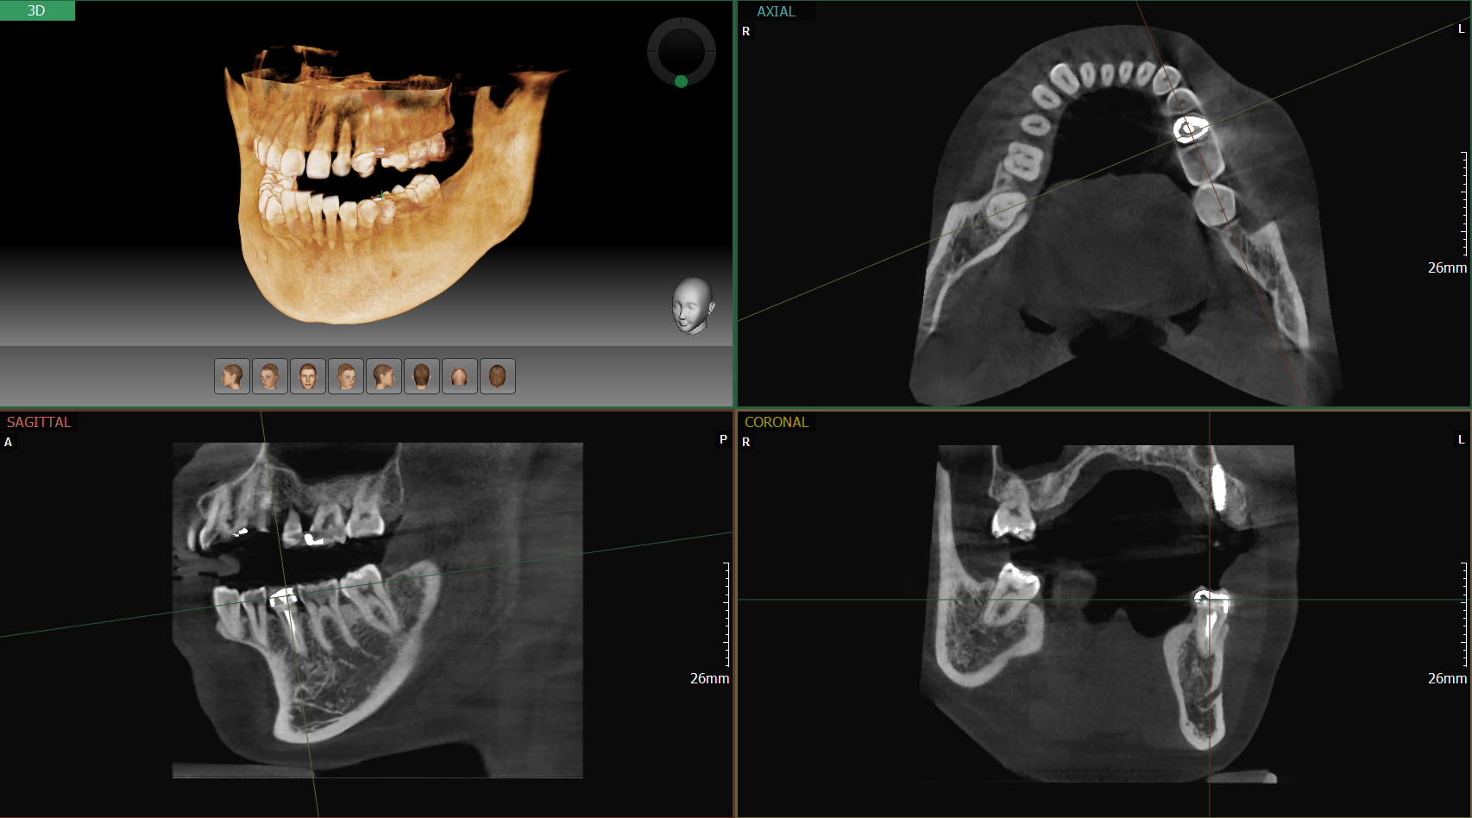
Green Innovation : One Scan, Two Images
[Sample Image : CT]

Slide 8
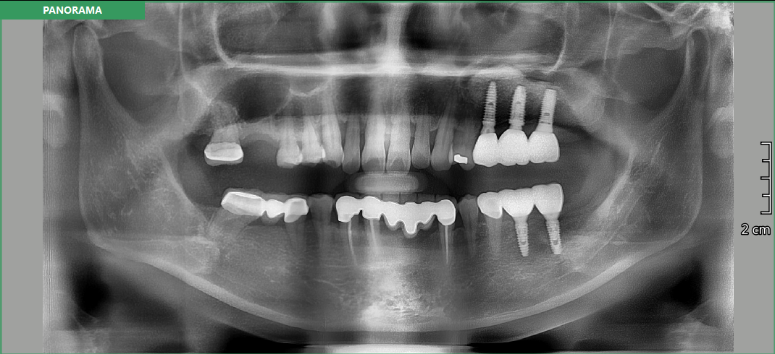
Green Innovation : One Scan, Two Images
[Sample Image : Real Pano]

Slide 9

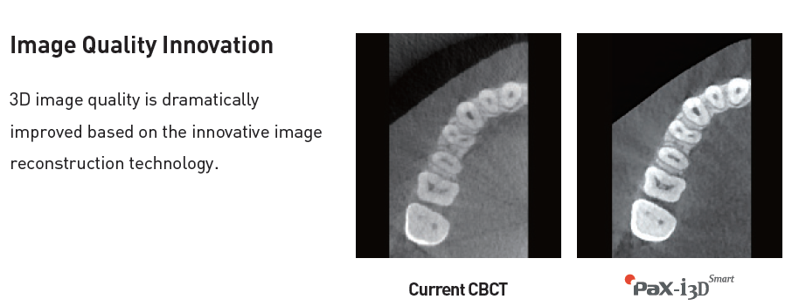
Image Quality Innovation : Reconstruction Technology
3D image quality is dramatically improved based on the innovative image
reconstruction technology.
In case of voxel size 0.2mm,
limitation resolution is 2.5lp.
2.5
Best
2.0
(2.2~2.3lp)
Optimal
Others
(1.6~1.8lp)
1.25
Normal
Notes:
센서에서 한계해상도의 50%는 Normal, 60%는 Optimal, 70~80%는 Best라 할 수 있음.
한계해상도는 ‘어떤 정도 이상은 표현할 수 없다’를 나타내는 것이다.
Pano의 경우, 90~100μm인데 한계해상도는 5lp이고 우리는 3.1lp(VT은 100μm)의 이다.
CT의 경우, 200voxel일 경우 한계해상도는 2.5lp이고 TUV(독일장치검사기관) 기준은 1lp라고 한다. (확인필요)
3D Smart의 경우 2.2~2.3lp나옴. 플란메카는 1.6lp 정도. (대부분 2lp under)

Slide 10
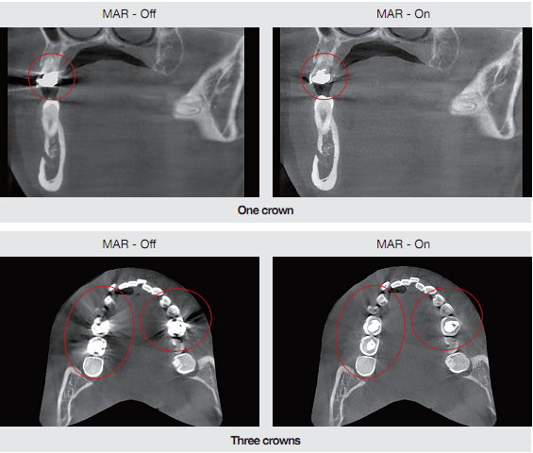
Image Quality Innovation : Auto-MAR Technology
PaX-i3D Smart is equipped with Al Auto MAR; it reduces metal artifacts based on
characteristics of each different metal. When there are more than three crowns,
MAR technology on each point is automatically adjusted.
Notes:
기존 장비는 MAR 기능이 on/off 였고,

Slide 11
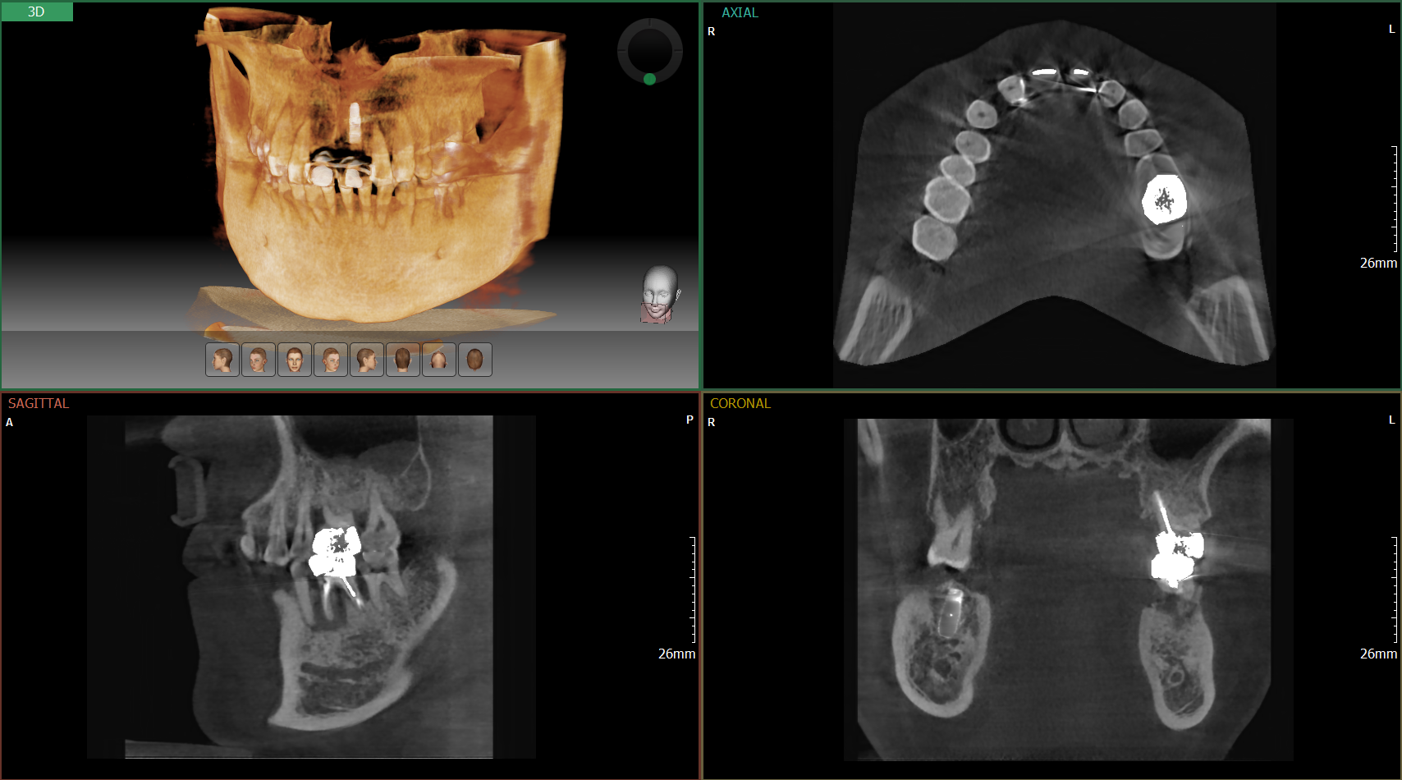
Image Quality Innovation : Auto-MAR Technology
[Sample Image : 2 Crowns ]

Slide 12

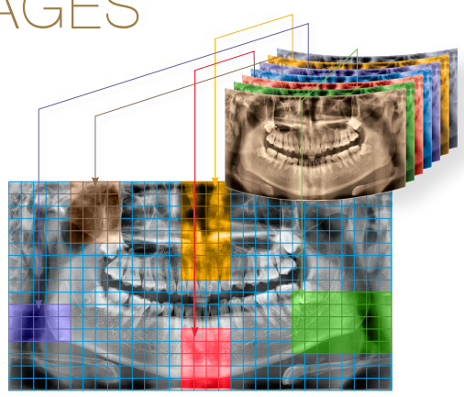
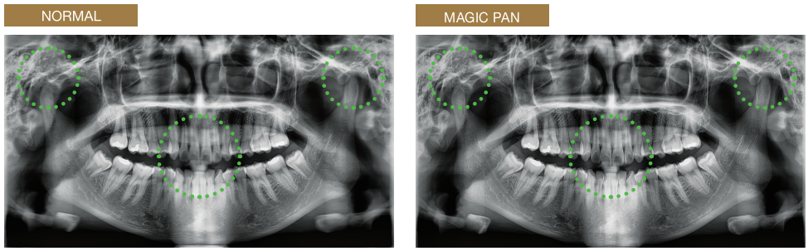
Image Quality Innovation : Magic PAN
Magic PAN creates a more superb panoramic image.
It is acquired through the elimination of distorted and
blurred images caused by improper patient positioning.
Focused image is reorganized throughout the whole dental arch and the image quality can
be increased. The image becomes clearer especially in the incisor and canine region, TMJ
areas and root canal.

Slide 13
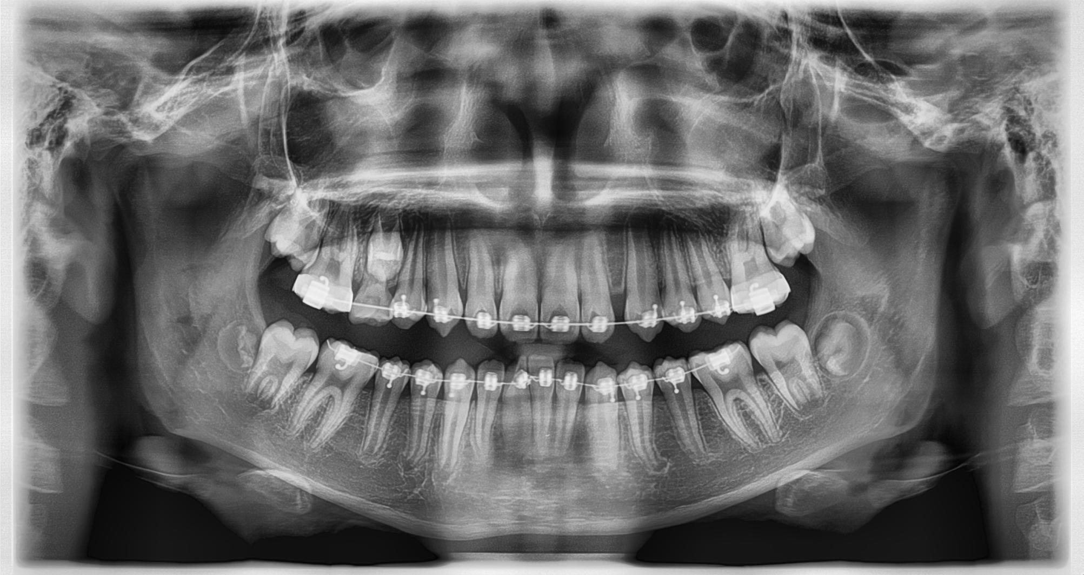
Image Quality Innovation : Magic PAN
[Sample Image : Normal]

Slide 14
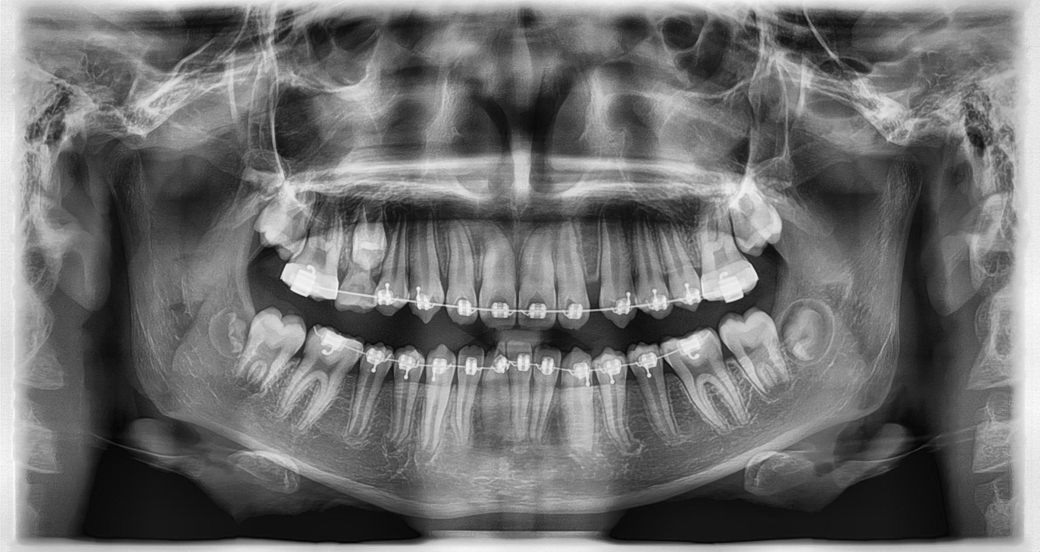
Image Quality Innovation : Magic PAN
[Sample Image : Magic PAN]

Slide 15

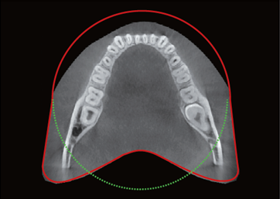
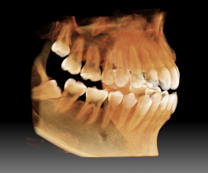
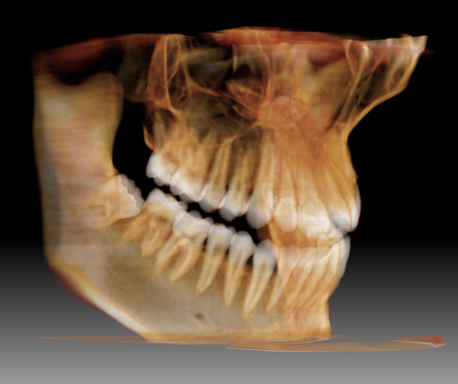
FOV Innovation : Arch-shaped Volume
Innovative FOV of PaX-i3D Smart provides arch-shaped volume and
it shows wider view of dentition than the same FOV of others.
Normally, FOV10x8.5 image shows tooth #8. However, when the tooth is lying on its side, there is high probability of having the tooth cut. “Arch-shaped Volume” eliminates this probability showing hidden area of dentition.

Slide 16
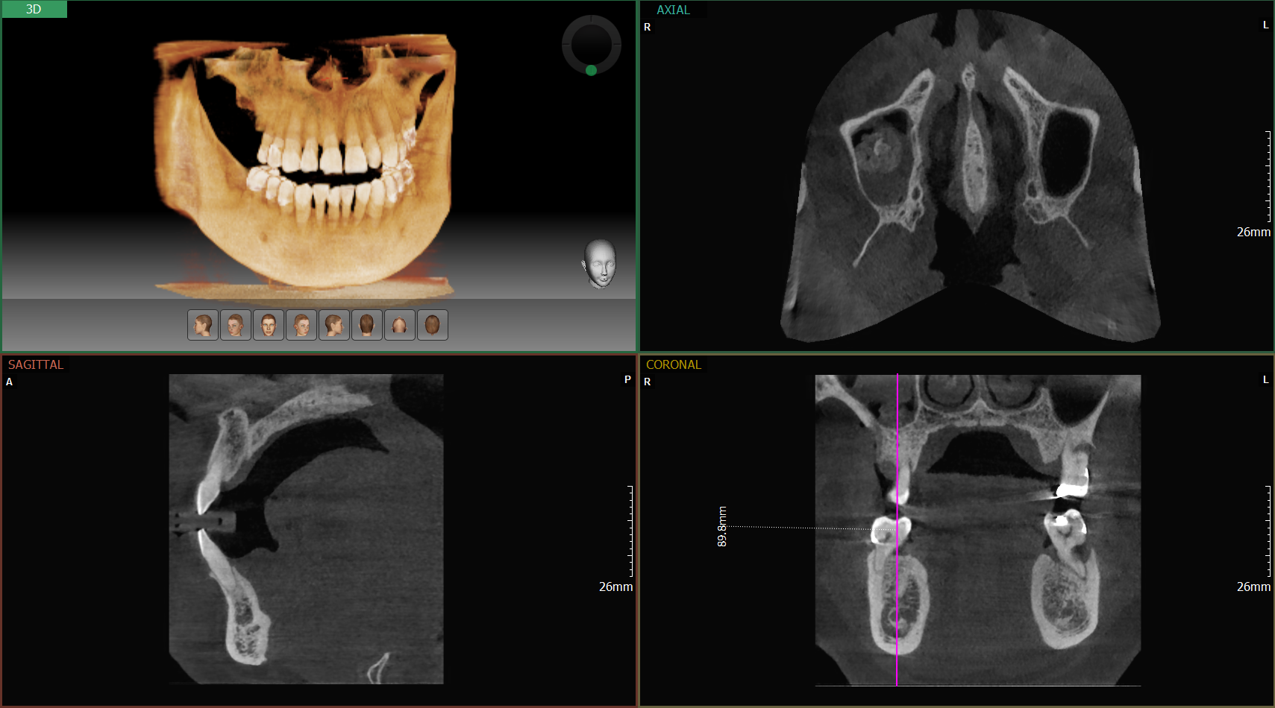
FOV Innovation : Extended 10x8.5
Innovative FOV of PaX-i3D Smart shows you more than 10x8.5.
It’s enough for sinus diagnosis.
89.8mm

Slide 17

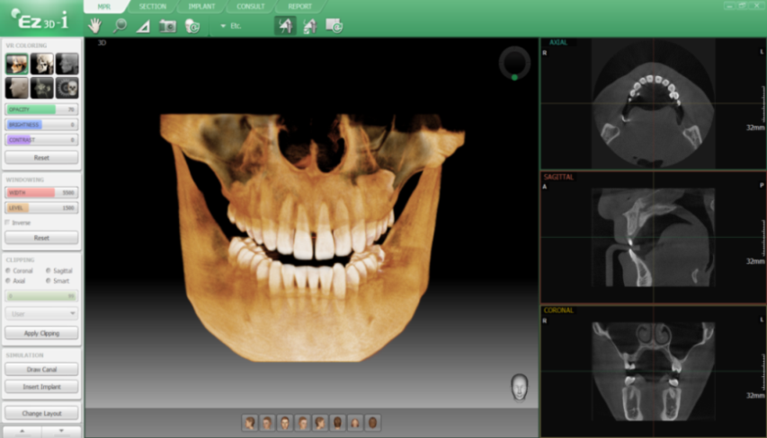



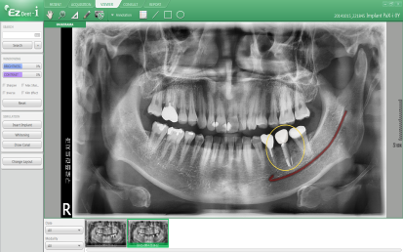
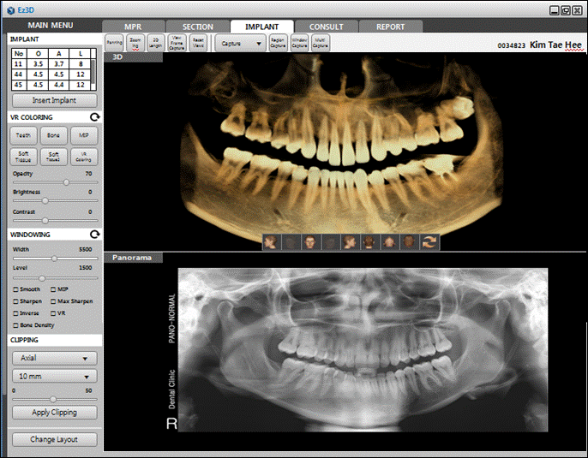
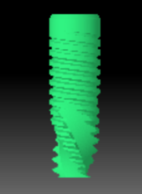
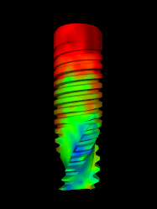
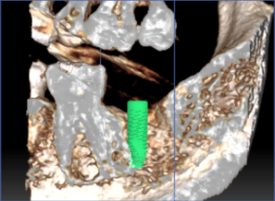
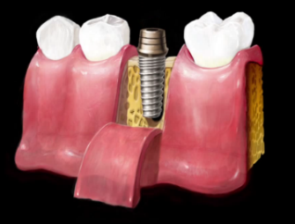
Software Innovation : Ez3D-i (V4.0)
Ez3D-i supports whole process of surgery.
Specialized functions for diagnosis and consultation make everything so convenient.
 | Diagnosis | High quality of VR Smart Clipping One Click Section
 | Simulation | 3-Step Implant Simulation Real Implant Fixture
 | Consultation | Implant Clipping 3D Bone Density EzCodi
2D Viewer: EzDent-i
3D Based diagnosis
3D Based consultation
Notes:
1) 3D Based의 영상 진단 뿐만 아니라, 전체 Surgery Process에도 굉장히 편리하다.
2) 3rd Party 연동 부분이 보완되면 함께 홍보할 수 있도록 할 것. (Surgical Guide / Implant Library)
3rd Party 연동과 관련된 비쥬얼 머테리얼 / 3rd Party supported

Slide 18
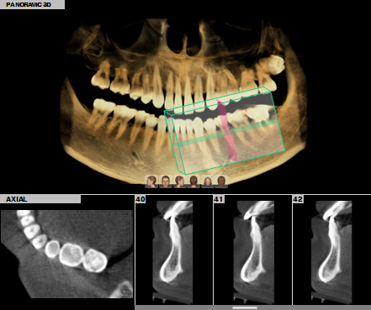
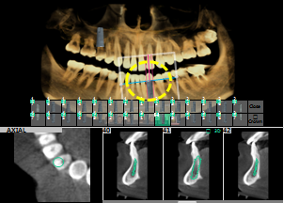
Software Innovation : Ez3D-i (V4.0)_to be released in 2015
3D PAN
[3D PAN] Tab of Ez3D-i makes everything “QUICK” and “SMART”. With “volume panorama”, lingual-side diagnosis is possible. Also, it supports effective and exact check of lesion’s location during endodontic treatment whether it’s near the apical or not.
One-Click for ROI diagnosis
1 sec. for cross-sectional images
No need complicated training course
Implant Simulation with 3D PAN
Easy multi-implant simulation (Top-down available)
Various modes for exact bone density

Slide 19
[Appendix] Technical Specification
Function | CT(with Real Pano) + Pano + Ceph
Focal Spot | 0.5 mm
CT FOV Size | Adult | 10x8.5 cm
 | Child | 10x7 cm
Voxel Size | 0.2 mm / 0.3 mm
Scan Time (sec.) | CT | 18 sec
 | Pano | 13.5 sec
 | Ceph | Scan : 12.9 sec / One-Shot : 0.9 sec
Recon. Time | CT | Max. 90 sec (10x8.5 cm / 0.2 mm Voxel Basis)
Gray Scale | 14 bit
Tube Voltage / Current | 50~99 kVp / 4~16 mA

Slide 20
Thank you.

